Slide 1

IOT Workshop Day-3
Organised by KURC in association with KUCC

Slide 2
Course Outline
Node MCU basics
Sensors and Data Fetching
Wi-fi and IOT
3rd Party Applications
IOT Project

Slide 3
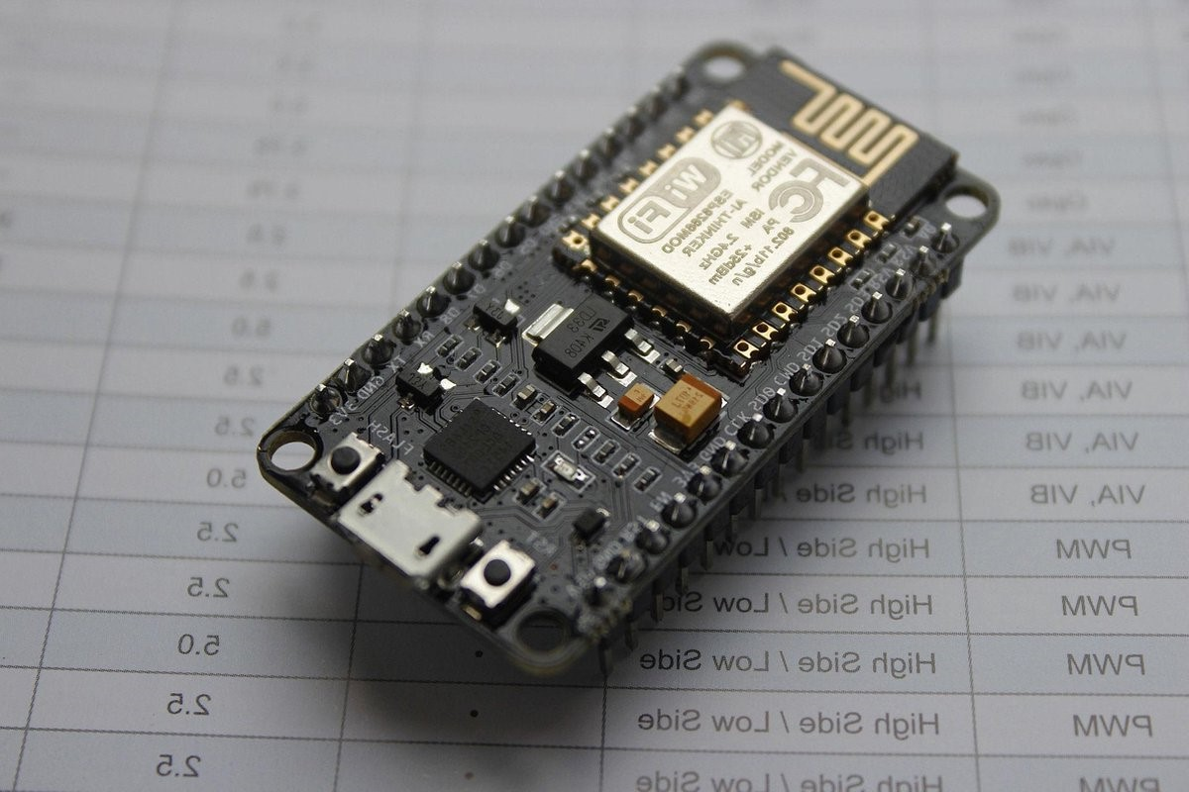
Course plan
Relay
Control pins via web server
Blynk IOT
Home automation project

Slide 4
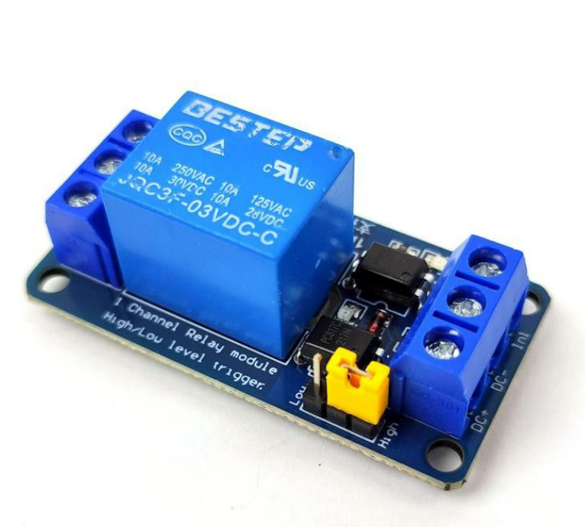
Relay
A relay is an electrically operated switch that uses an electromagnet to mechanically operate a set of contacts. It allows a low-power signal to control a high-power circuit, enabling safe and efficient control of electrical devices. Relays are commonly used in automation, industrial control systems, and electronic circuits where it's necessary to isolate the control signal from the high-power load.

Slide 5
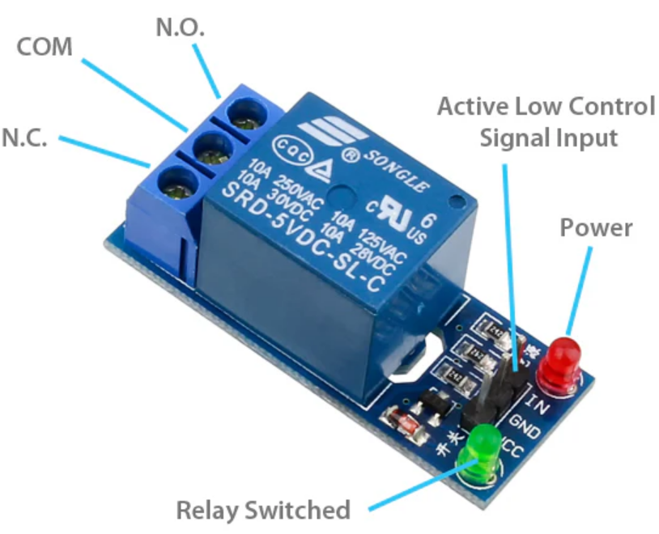
Relay
Normally Closed:
Default State: The contacts are closed, meaning the circuit is complete, and current can flow through.
Normally Open:
Default State: The contacts are open, meaning the circuit is broken, and no current flows through.

Slide 6
Relay task 1:
First run the webserver that we built yesterday.
Connect the relay to power source we have provided.
Attach the motor to the relay.
The use the D4 pin to control the relay

Slide 7

Home automation project
Functionalities:
Turn lights on and off
Turn fan on and off
Show humidity and temperature//
Notification if air quality change
Water level

Slide 8
Blynk IOT
Blynk IoT is a platform designed to create Internet of Things (IoT) applications with minimal coding and setup. It allows users to build mobile and web applications to control and monitor hardware devices remotely. Blynk offers a variety of features and tools to simplify the development process for both hobbyists and professionals.

Slide 9

Blynk IOT
Create a Project: Use the Blynk app to create a new project and configure the widgets.
Connect Hardware: Use the Blynk library to write firmware that connects your hardware to the Blynk server.
Control and Monitor: Use the Blynk app to control the hardware and monitor sensor data in real-time.
Course plan
Introduction
Protocols
Application

Slide 10
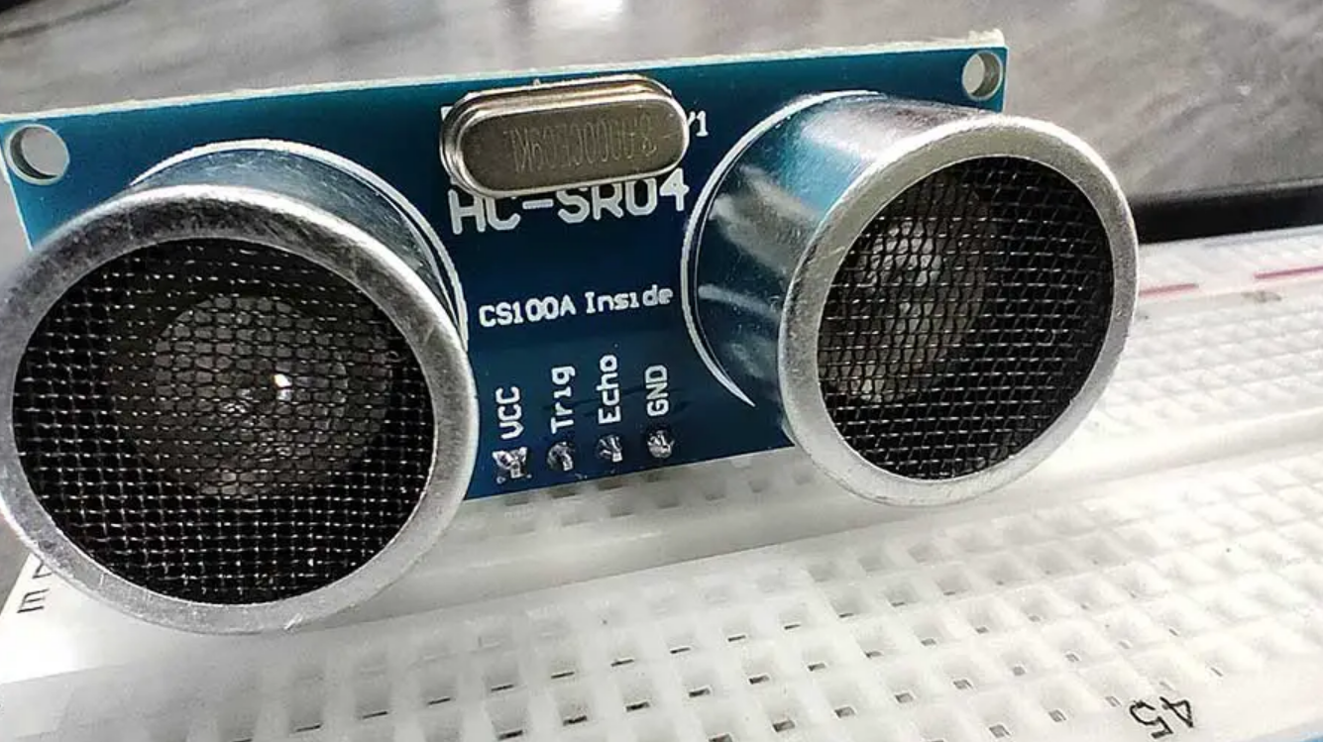
Ultrasonic sensor
An ultrasonic sensor measures distance by using ultrasonic waves. It emits a sound wave at a frequency above the range of human hearing and measures the time it takes for the sound to bounce back from an object.
It relies on transmission, reception and distance calculation
Pin config is VCC, TRIG, ECHO, AND GND

Slide 11
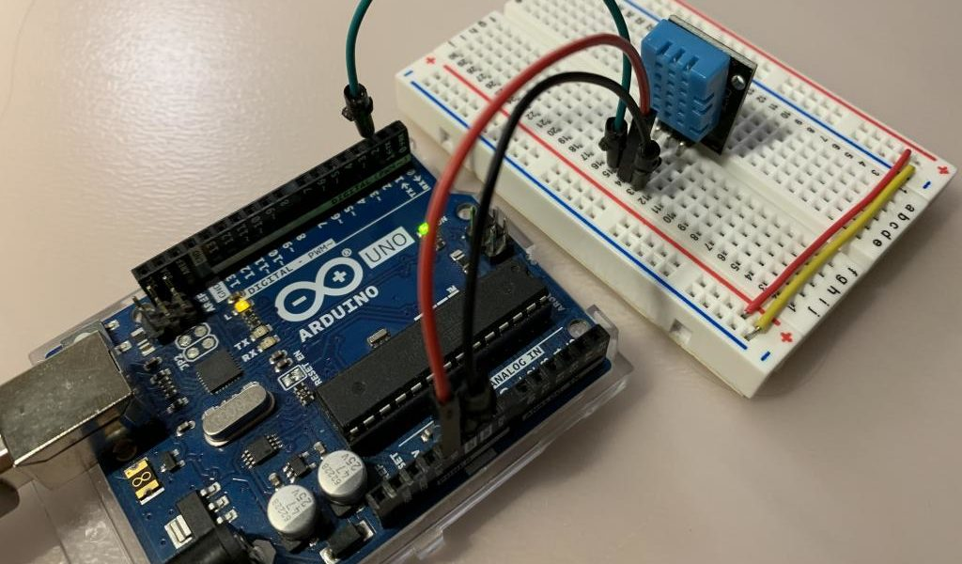
DHT11 sensor
The DHT11 uses a capacitive humidity sensor. It consists of two electrodes with a moisture-holding substrate between them. As the humidity changes, the conductivity of the substrate changes, affecting the capacitance between the electrodes.
The temperature sensor is a thermistor, a type of resistor whose resistance changes with temperature. It is typically a Negative Temperature Coefficient (NTC) thermistor, meaning its resistance decreases as the temperature increases.

Slide 12
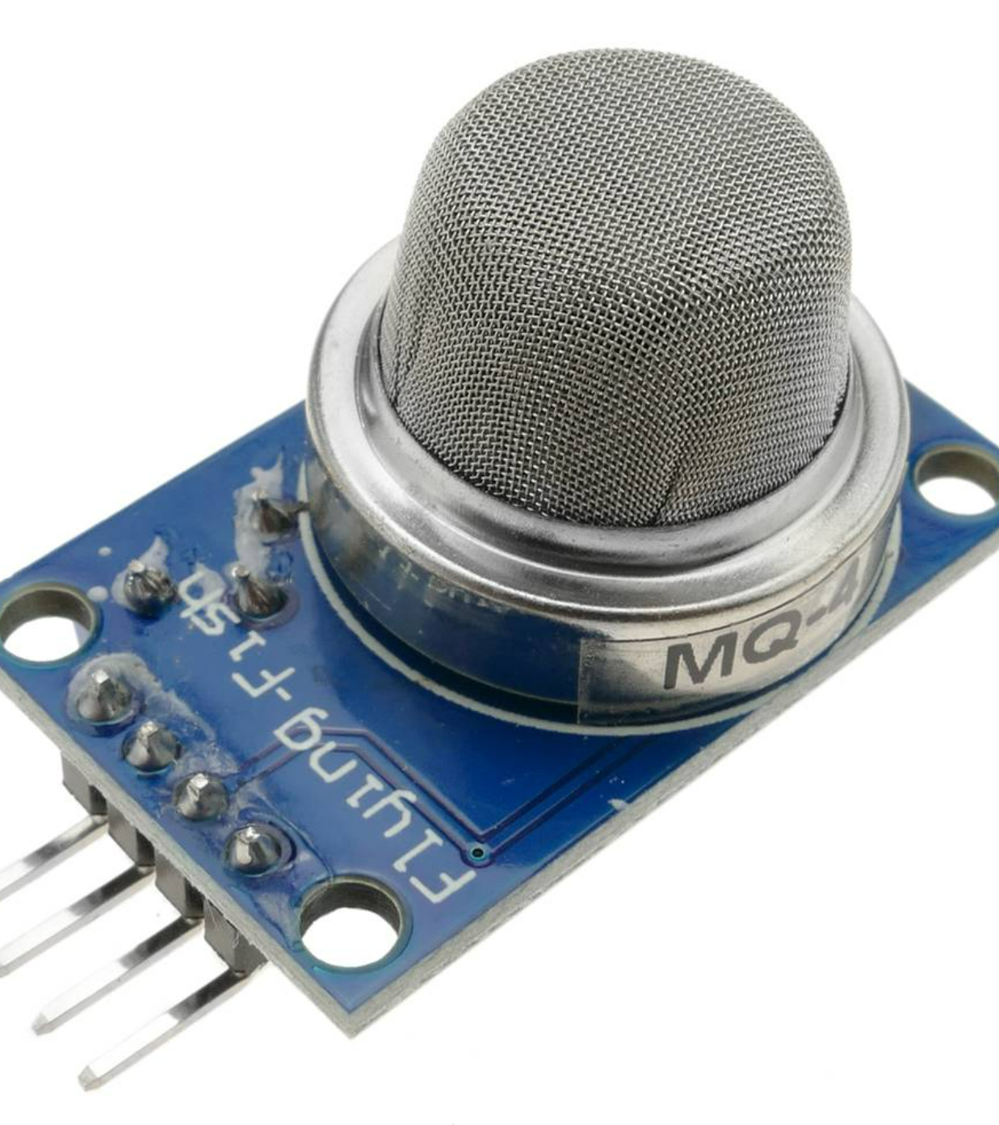
MQ sensors
Working Principle
Heating the Sensing ElementHeater Coil: Brings the sensor to an optimal temperature for detecting gases.
The sensing element interacts with the gas molecules. The presence of target gases alters the resistance of the chemical layer on the sensing element.
The change in resistance is converted into an analog signal.
The analog signal can be read and processed by a microcontroller to determine gas concentration.

Slide 13
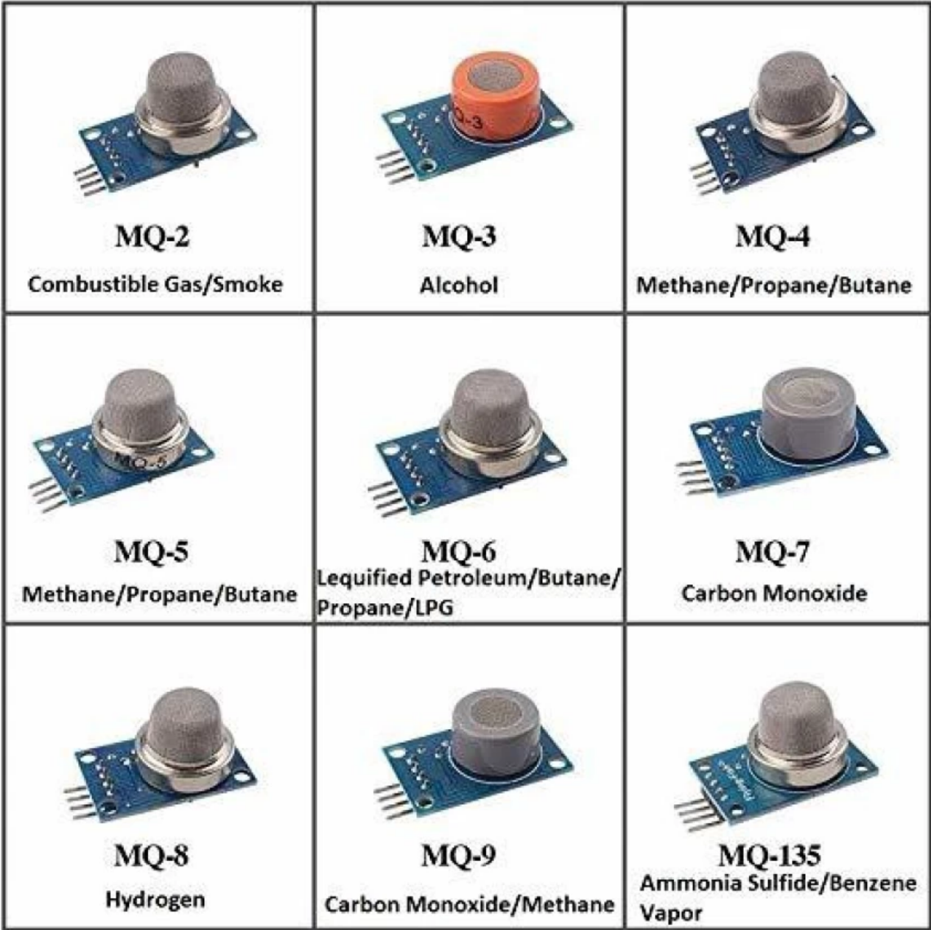
Types of MQ sensor
MQ sensors are a series of gas sensors used for detecting various gases in the air.
We will be using MQ-2 sensor in the following session.
MQ-2 Detects: LPG, Methane, Hydrogen, Smoke

Slide 14
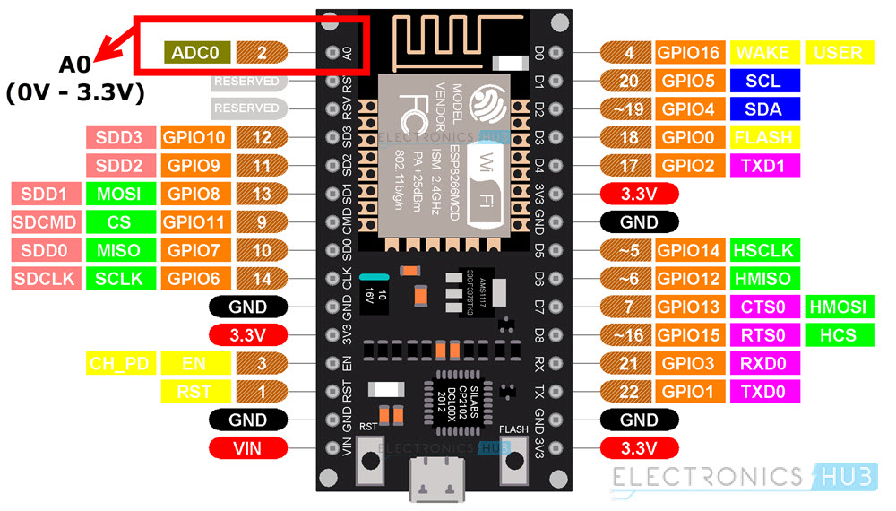
Analog pin
The ESP8266 has only one ADC pin, labeled as A0 or ADC0.
The ADC on the ESP8266 is a 10-bit ADC. This means it can represent the input voltage with 1024 discrete levels, ranging from 0 to 1023.

Slide 15
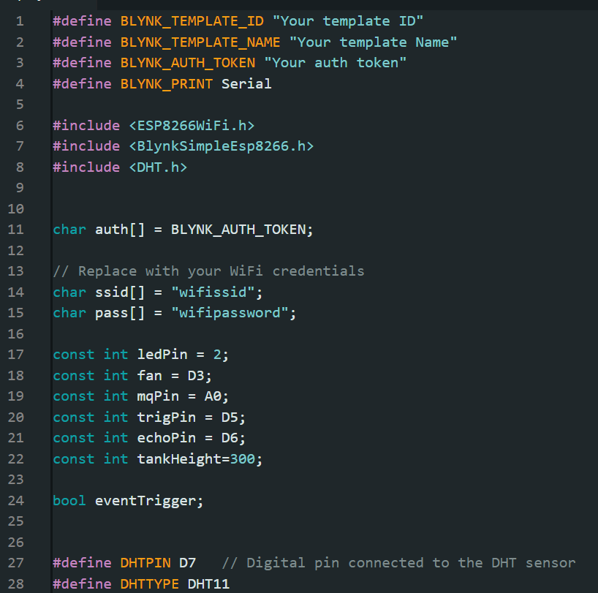
Home automation
BLYNK_WRITE(V0): Control LED
BLYNK_WRITE(V1): Control Fan
dhtData(): Read and log temperature & humidity from DHT11
sensorairquality(): Read and log air quality from MQ sensor, trigger Blynk event on hazard
tank(): Measure and log water tank level using ultrasonic sensor
Find this code at :
https://github.com/ganymede451/iot

Slide 16
Home automation
BLYNK_WRITE(V0): Control LED
BLYNK_WRITE(V1): Control Fan
dhtData(): Read and log temperature & humidity from DHT11
sensorairquality(): Read and log air quality from MQ sensor, trigger Blynk event on hazard
tank(): Measure and log water tank level using ultrasonic sensor
Find this code at :
https://github.com/ganymede451/iot

Slide 17
Home automation
BLYNK_WRITE(V0): Control LED
BLYNK_WRITE(V1): Control Fan
dhtData(): Read and log temperature & humidity from DHT11
sensorairquality(): Read and log air quality from MQ sensor, trigger Blynk event on hazard
tank(): Measure and log water tank level using ultrasonic sensor
Find this code at :
https://github.com/ganymede451/iot

Slide 18
Pins in Blynk IOT
V0: LED switch
V1: fan switch
V3: Temperature Gauge
V2: Humidity Gauge
V4: Tank water percentage gauge

Slide 19
End of Day 3
Organised by KURC in collaboration with KUCC

